Slide 1
E-Kart
An e-Commerce Website
Submitted By –
Ayush Singhal {181500181}
Aditya Pratap Singh {181500045}
Yashvardhan {181500833}
Submitted To –
Mr. Anand Prakash Gupta
Mrs. Ruchi Gupta
Technical Trainer

Slide 2
WHY DO WE NEED THIS PROJECT
The idea of this project arose on our mind when due to Covid19, last year was very tormenting for humans and was a period of great depression in terms of both economy and development, as we all know the development of a country is measured by its economy and because of the pandemic the main booster or we can say the most popular way of shopping has become online shopping but as we know it can be sometimes difficult to use for children and older age groups and they have to rely on others to do that for them. Our goal is to create a simple website which can easily used by anyone from various age groups.

Slide 3
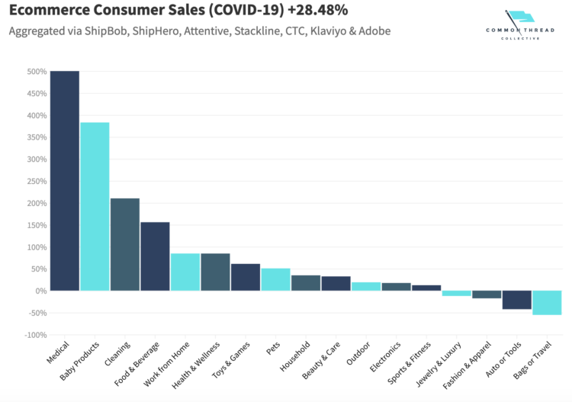
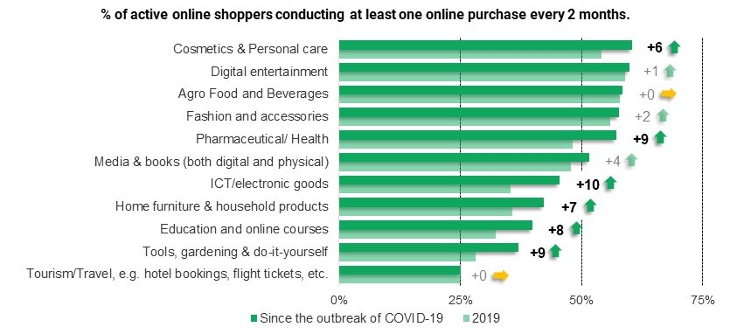
Stats regarding increase in Online Shopping during Corona Pandemic

Slide 4
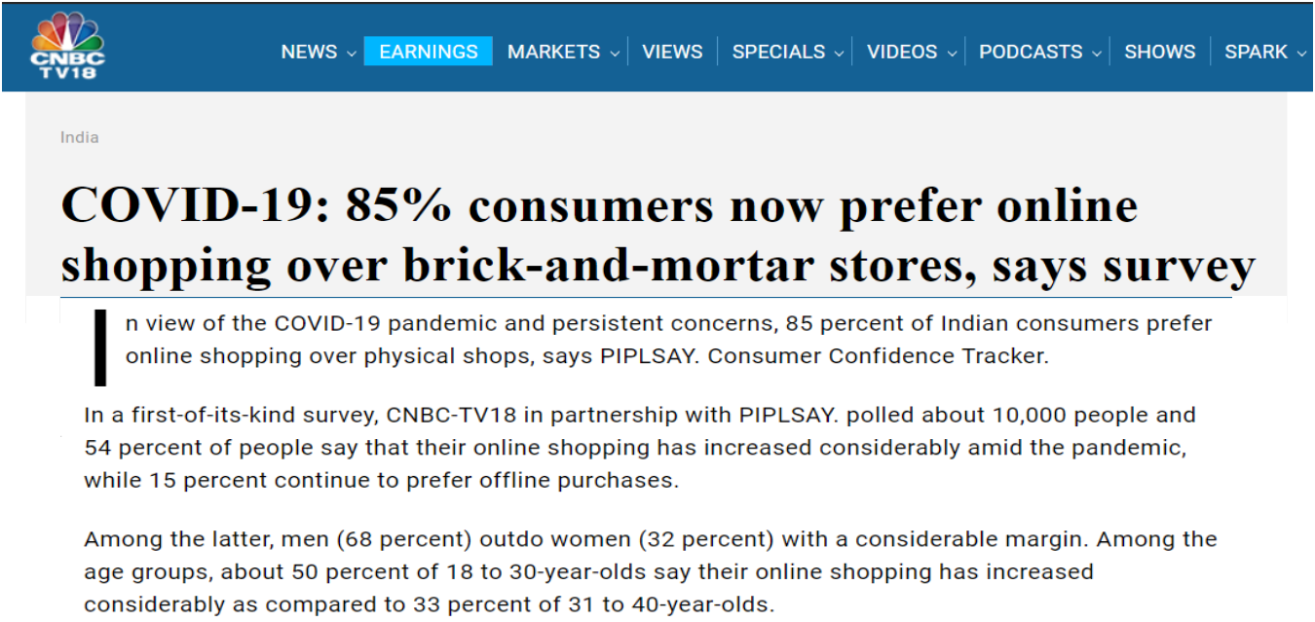
Survey by CNBC of increase in Online Shopping during Pandemic

Slide 5
As we can see from the above images and data that after the Corona outbreak, mostly people starts doing online shopping and avoids offline Shopping which results in increase in online shopping.
This will help in :
Providing a platform for Shop Owners in reaching to Customers.
Users to view detailed description of each product.
Minimizing the gap in between Shop Owners and Customers.

Slide 6
The Home Page contains :
Nav Bar : It contains ‘Logo’, ‘Shop’, ‘Login / Register’ and ‘Cart’ option to navigate to their respective pages.
Menu Bar: It provides option for user to search a product, sorting and apply filters according to categories.
Cart
Order History
Cards : To display the items.

Slide 7
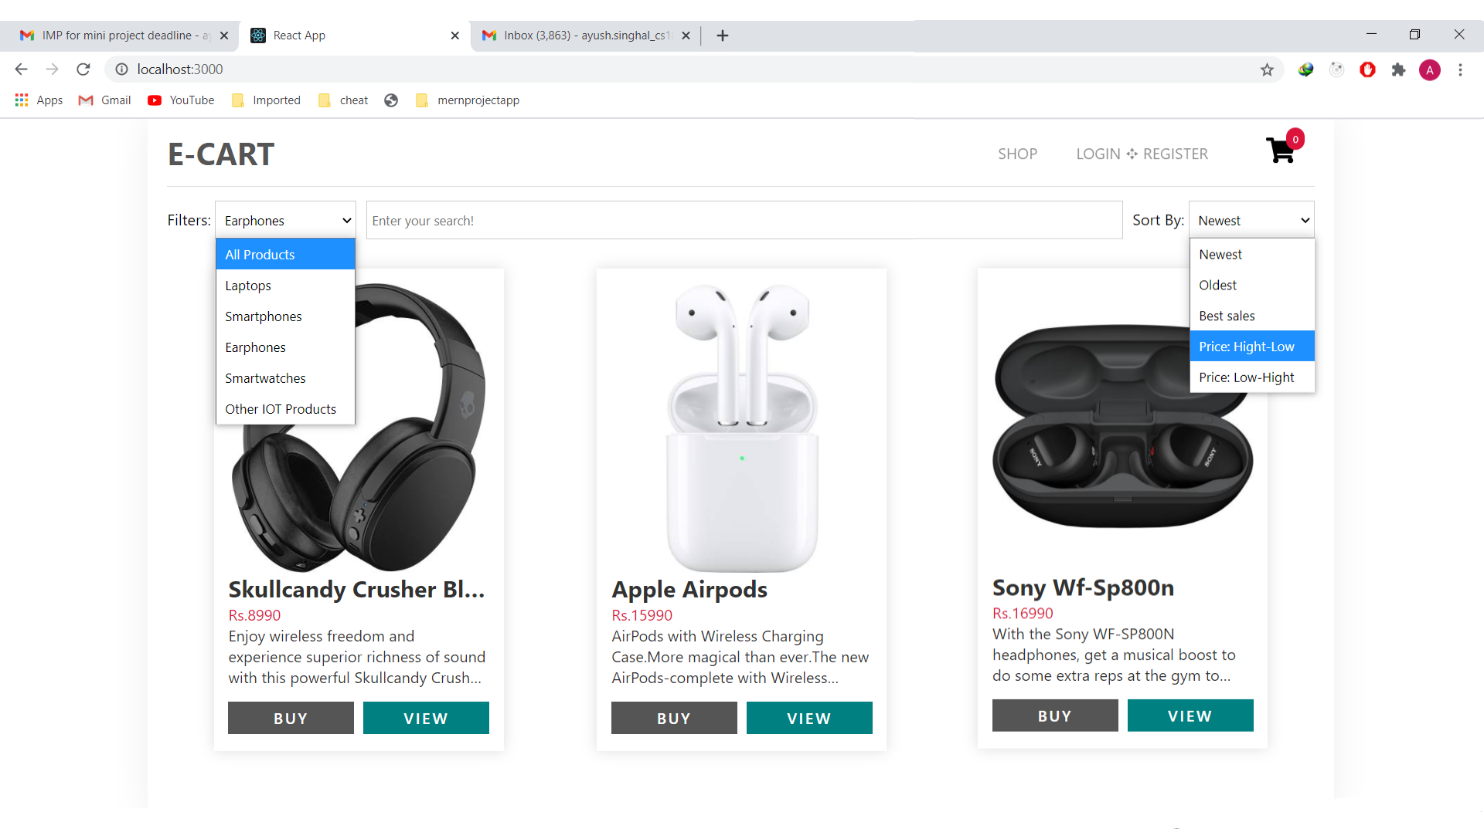
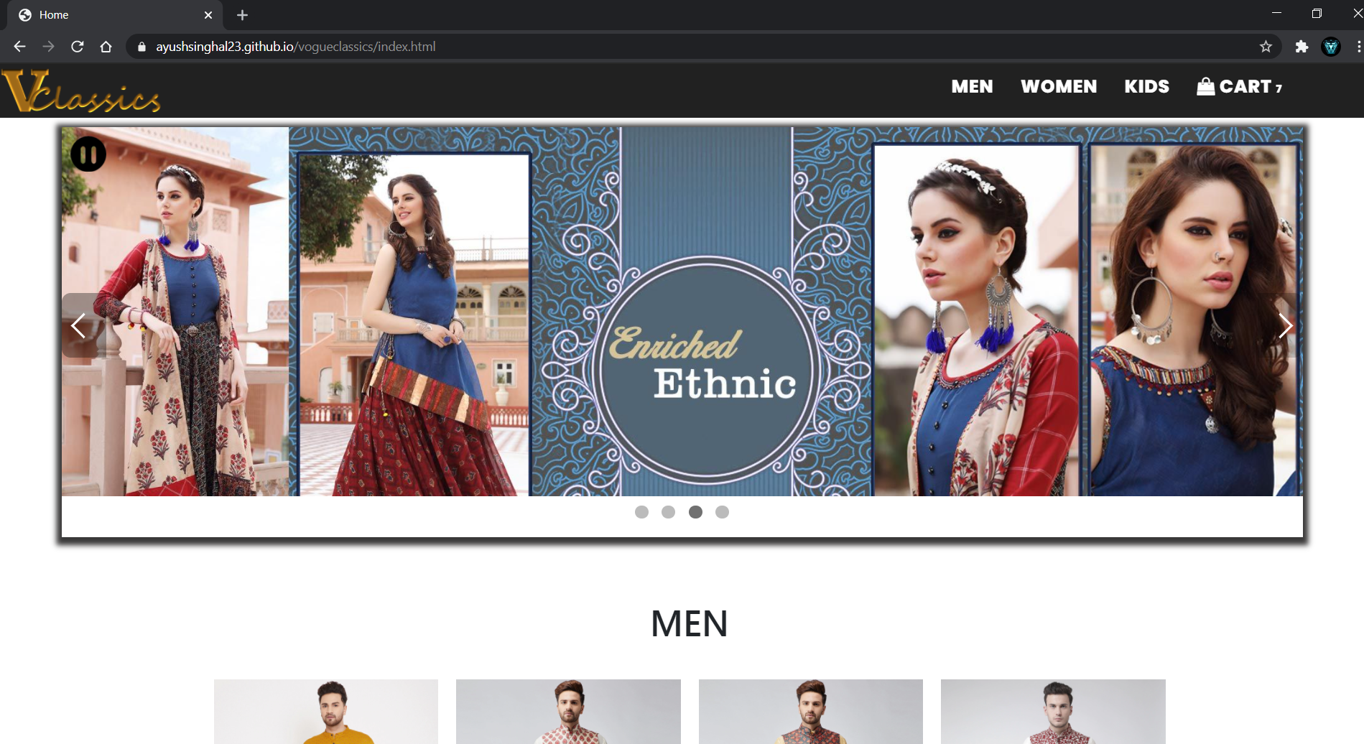
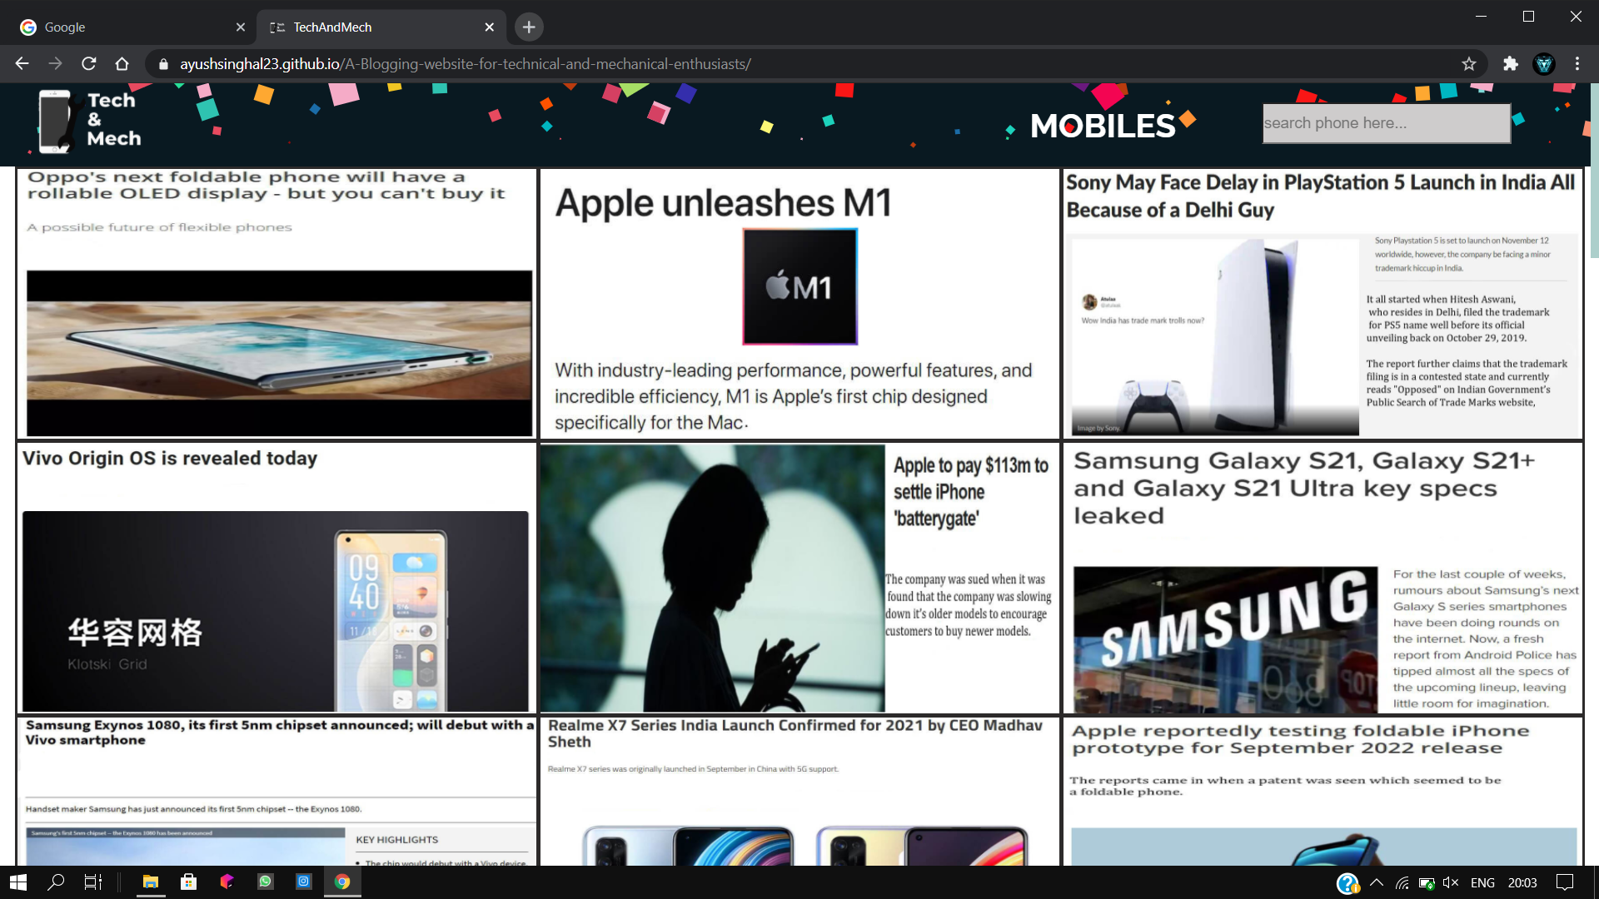
Nav Bar
Menu Bar for Sorting and Filtering
Menu Bar for Sorting and Filtering

Slide 8
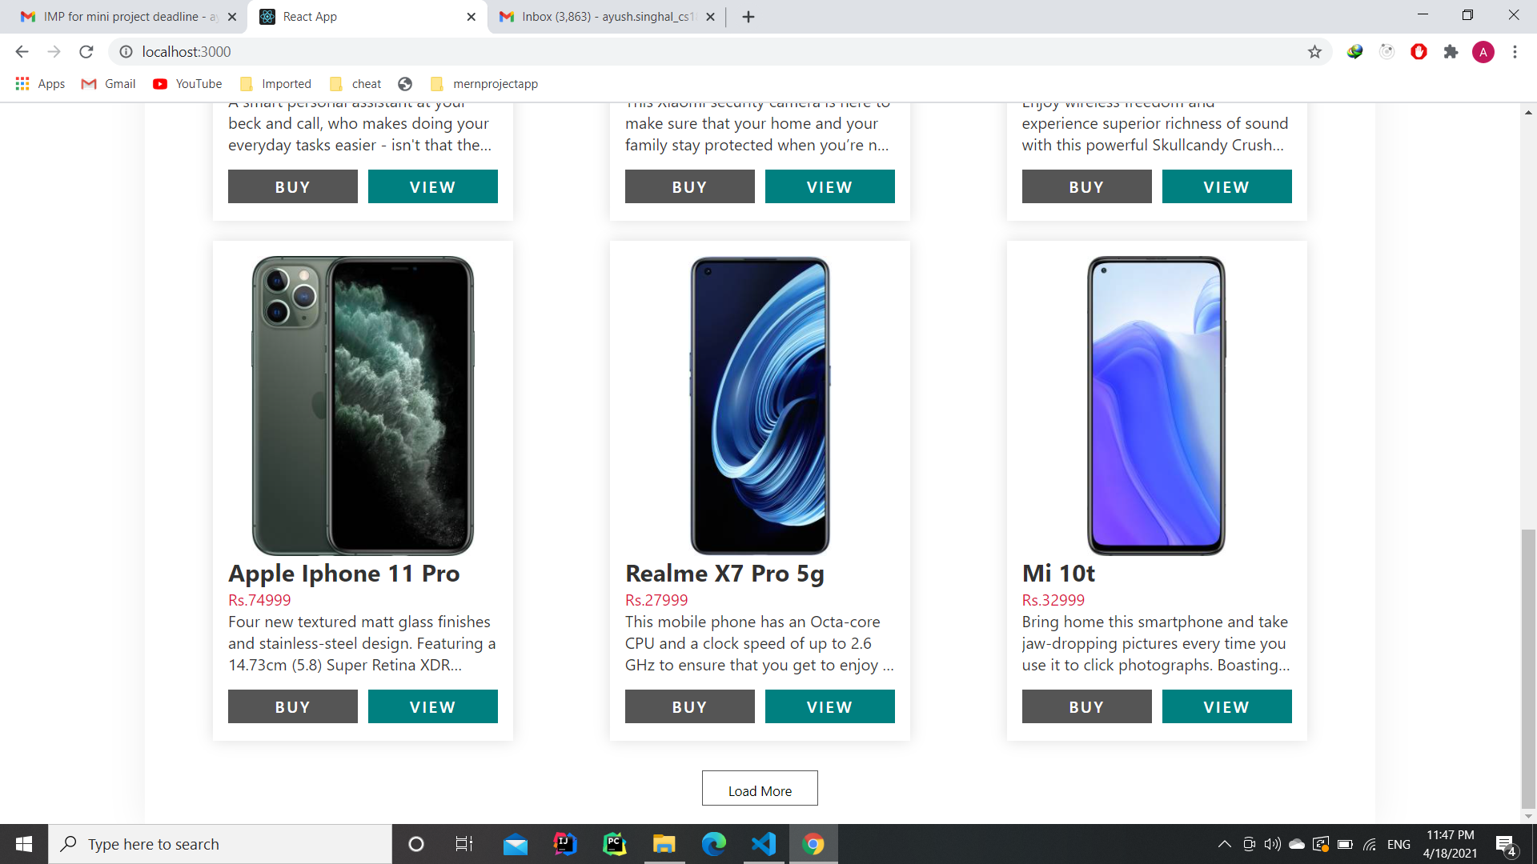
Load More Button

Slide 9
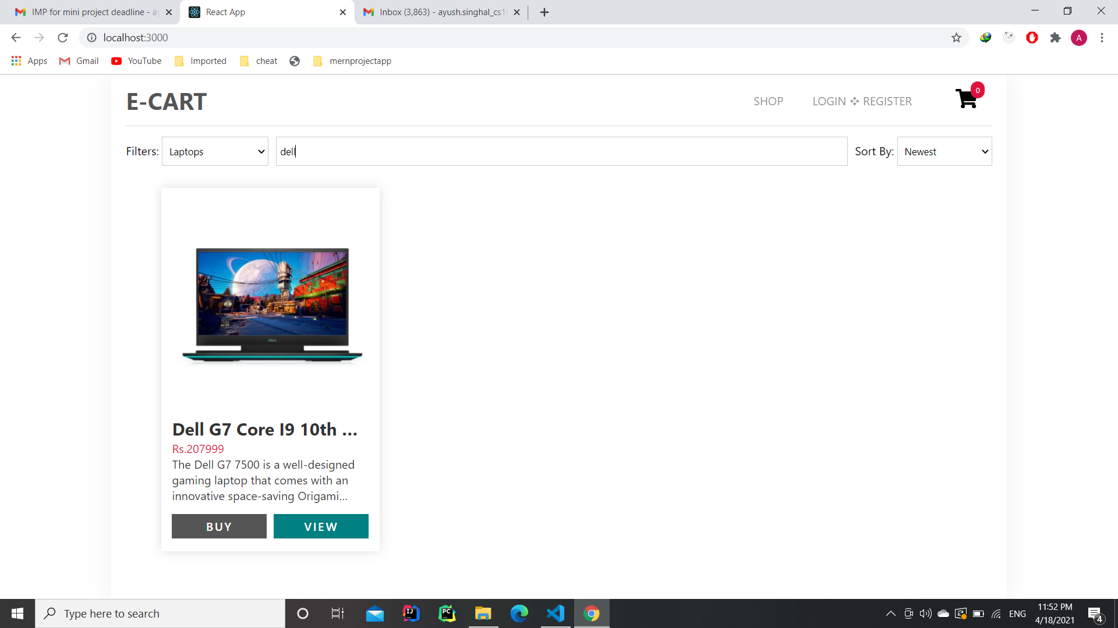
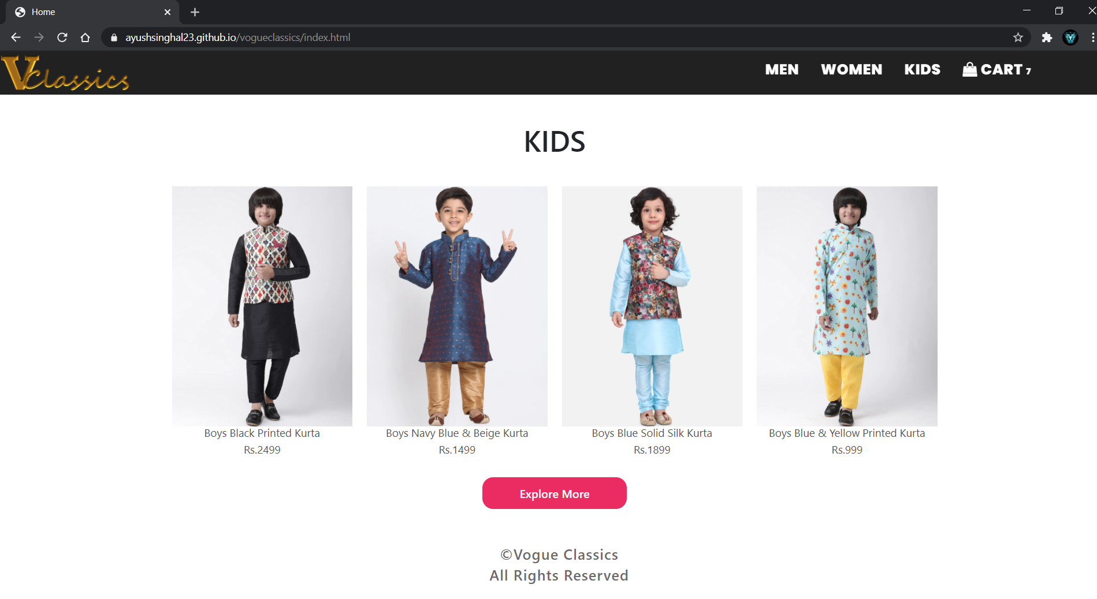
Cart
Search Bar

Slide 10
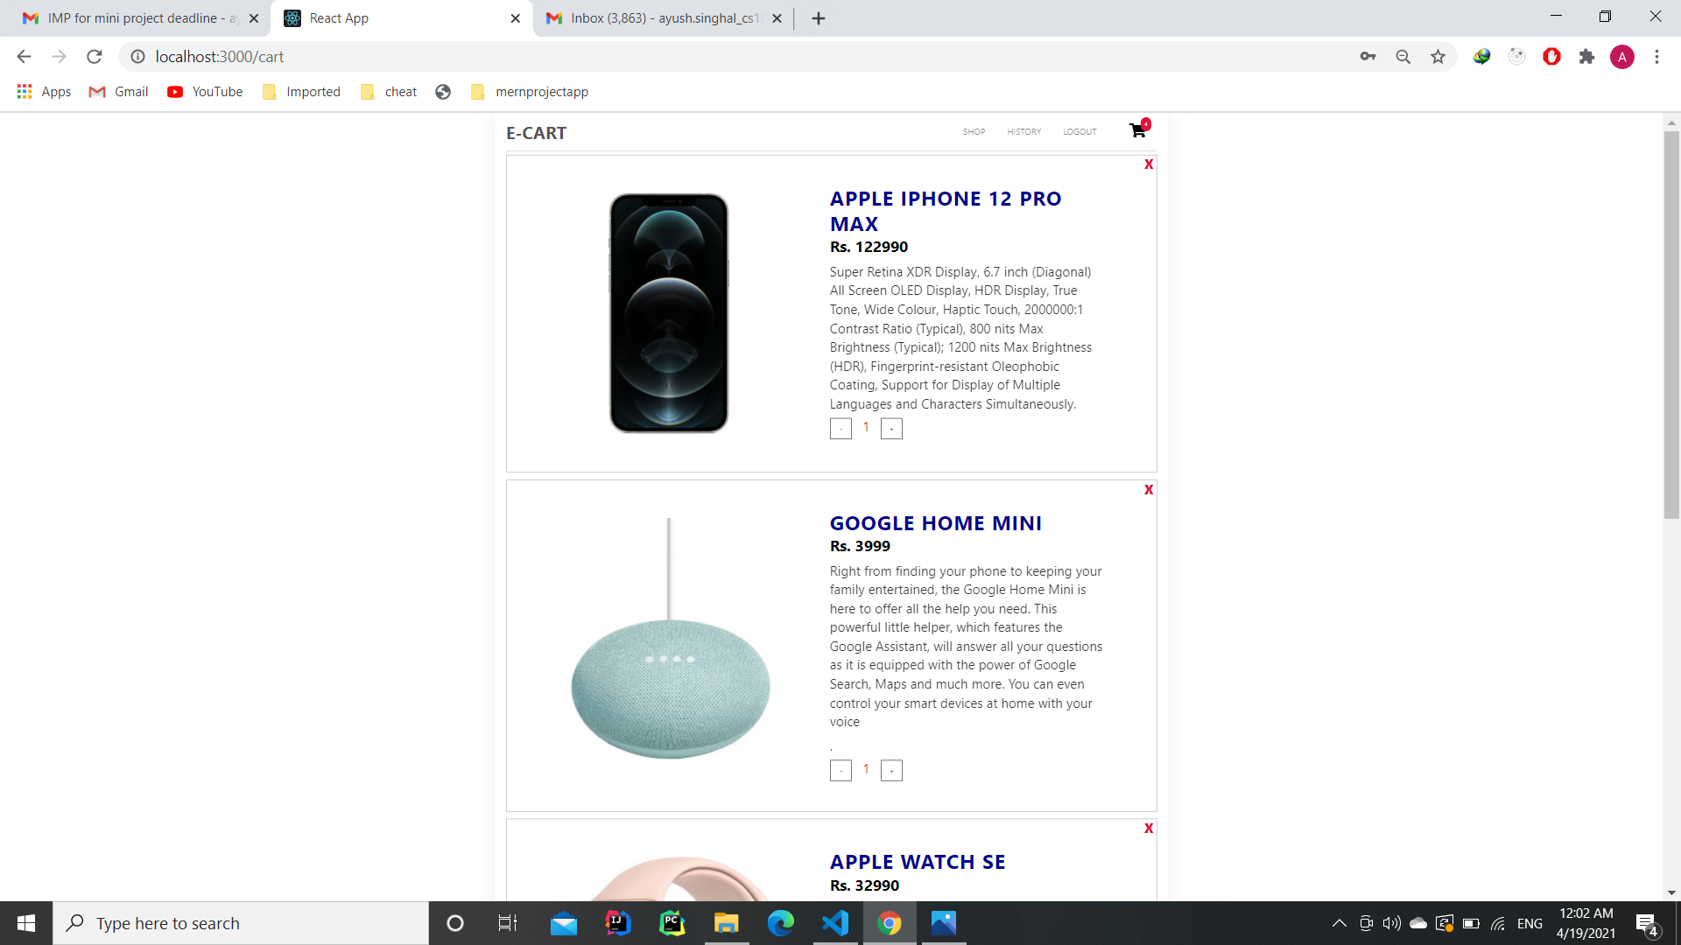
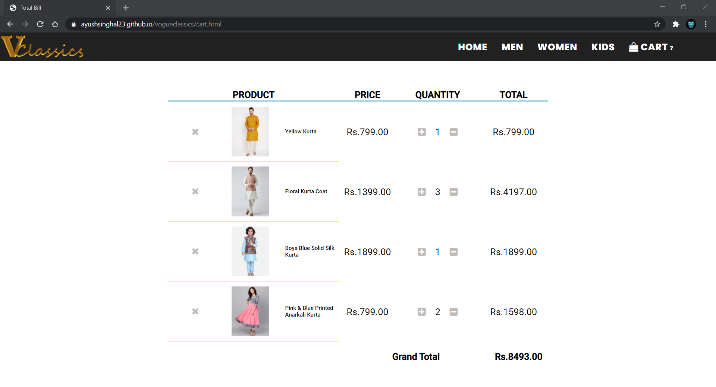
Cart

Slide 11
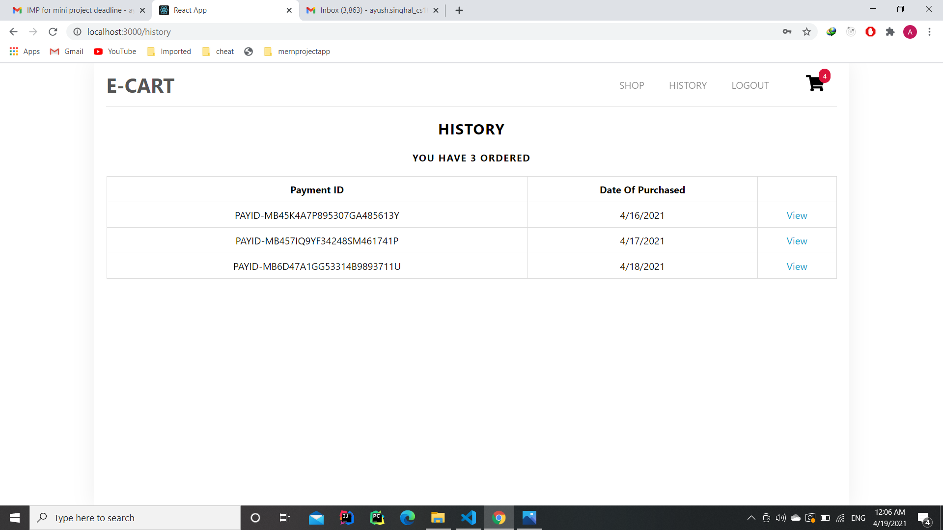
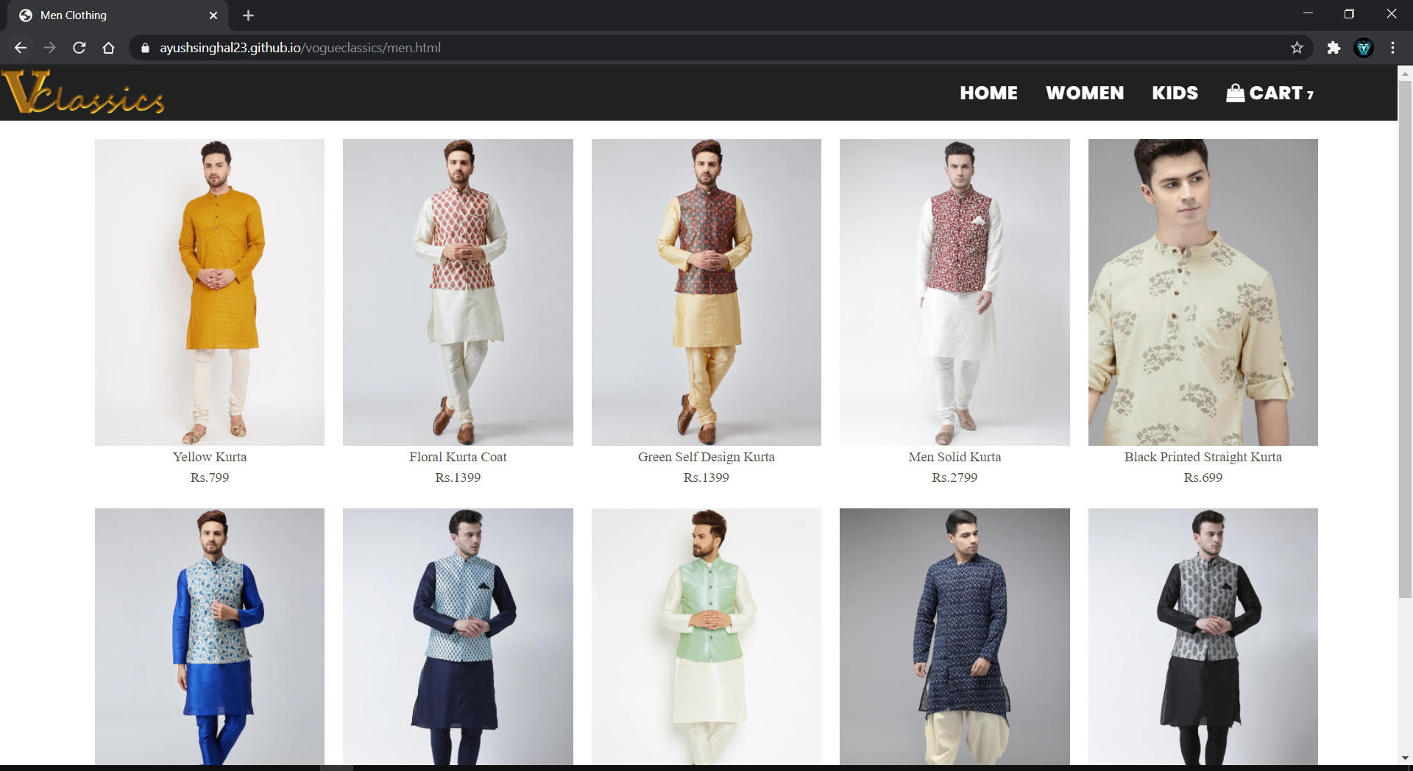
Order History

Slide 12
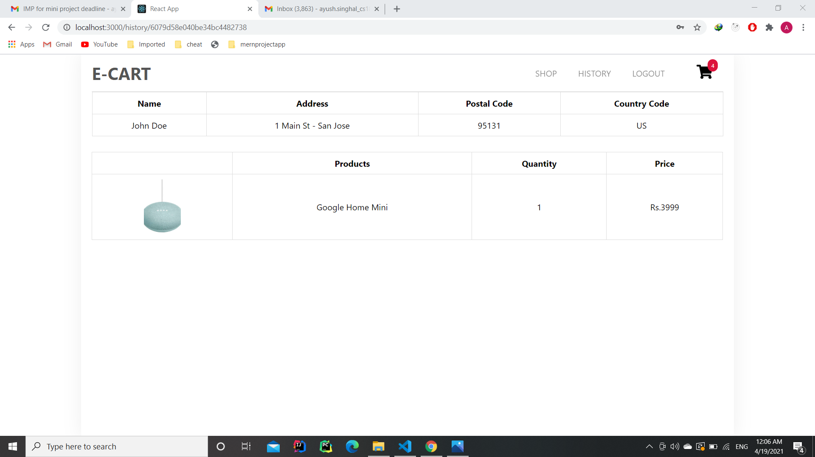
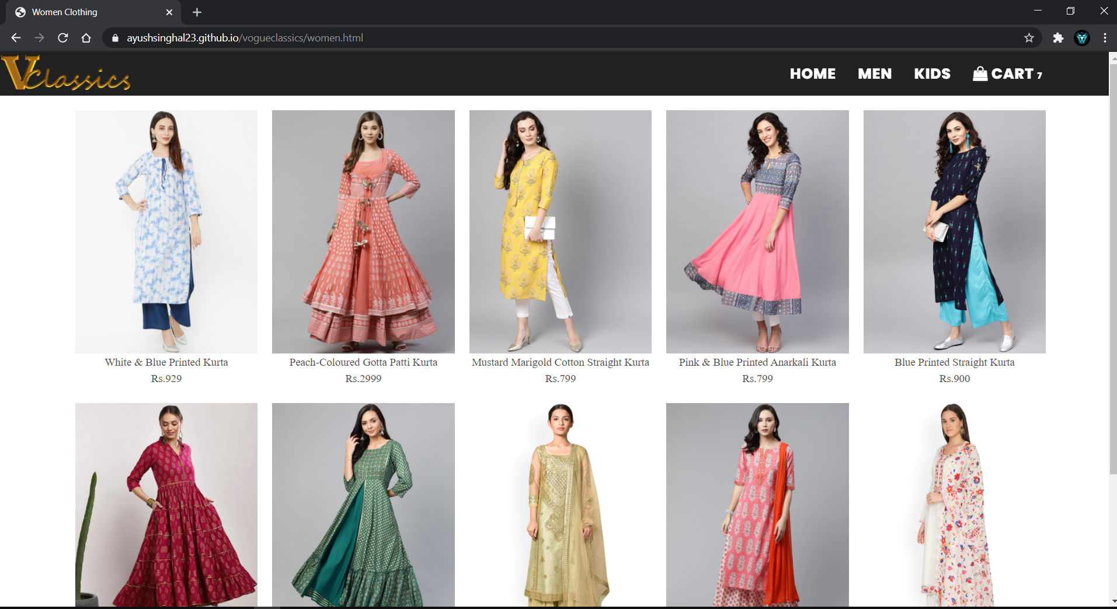
Order History (After Clicking View Button)

Slide 13
Admin Dashboard contains :
Adding a New Product
Creating / Editing Categories
Updating a Product
Deleting a Product
Deleting Multiple Products

Slide 14
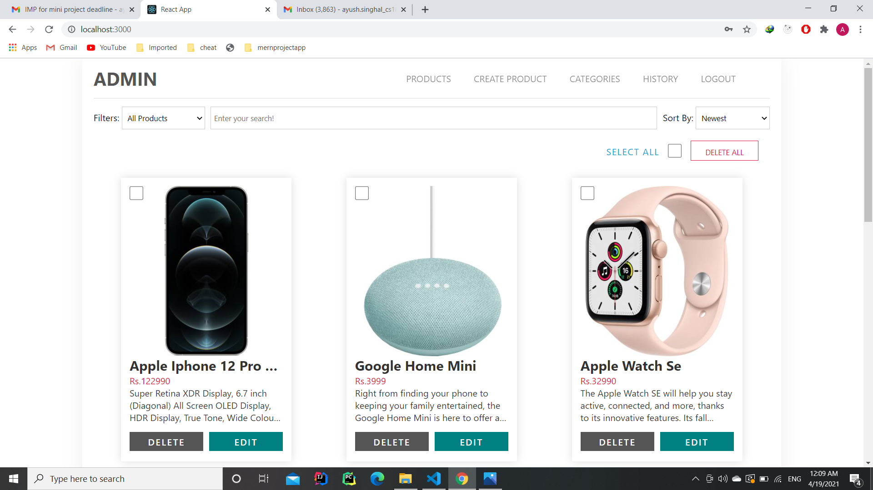
Admin Dashboard

Slide 15
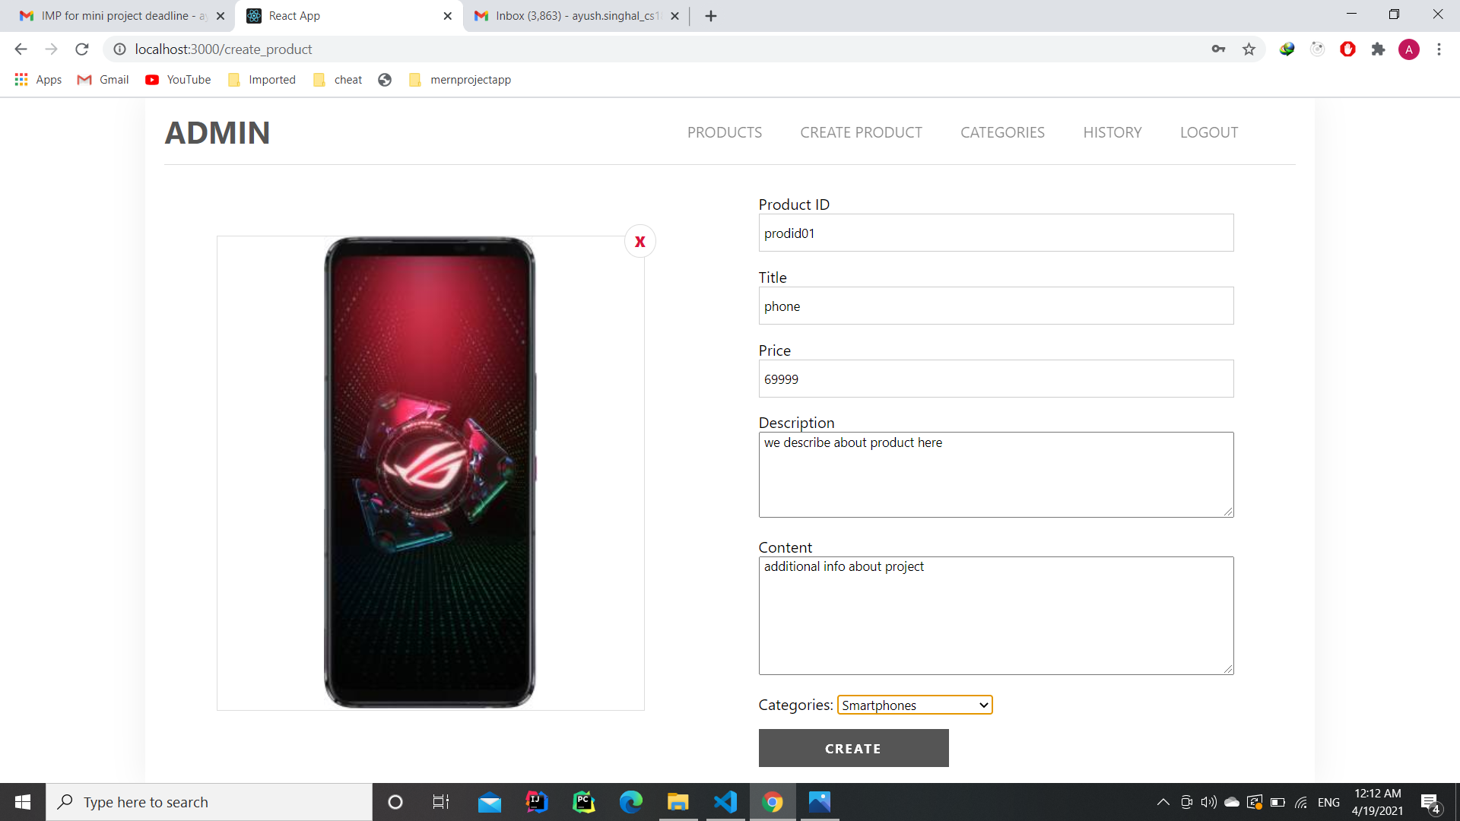
Product Creation

Slide 16
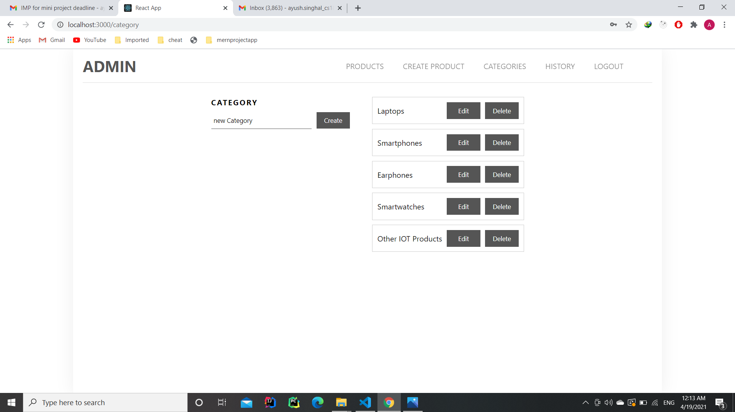
Create or Edit Categories

Slide 17
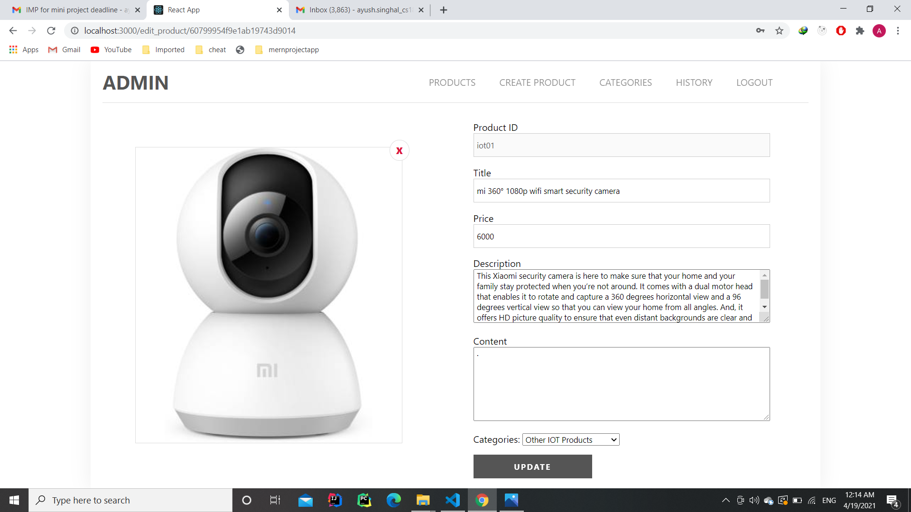
Update Product

Slide 18
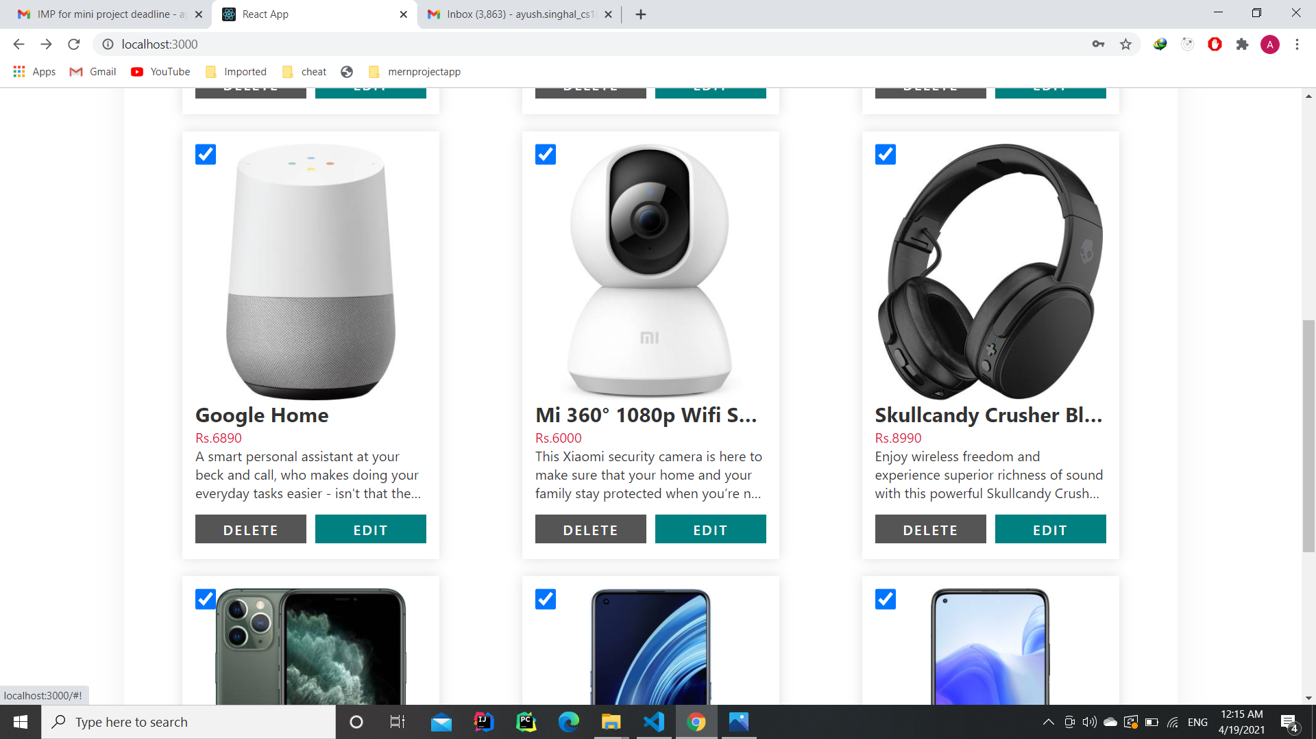
Delete a Product

Slide 19
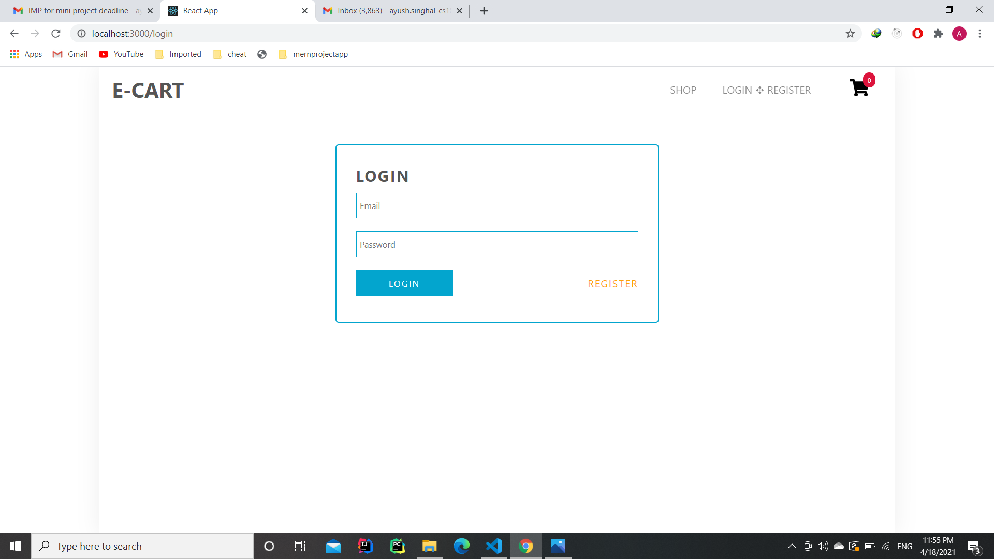
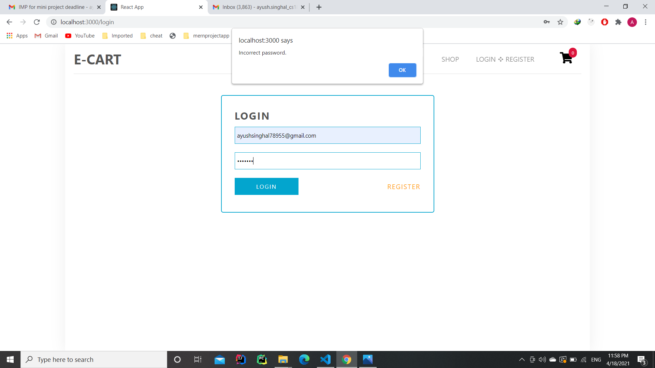
Logging In
After Filling out the Credentials

Slide 20
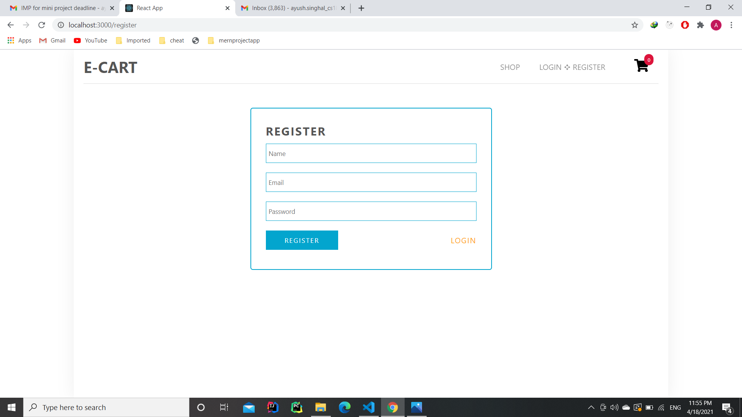
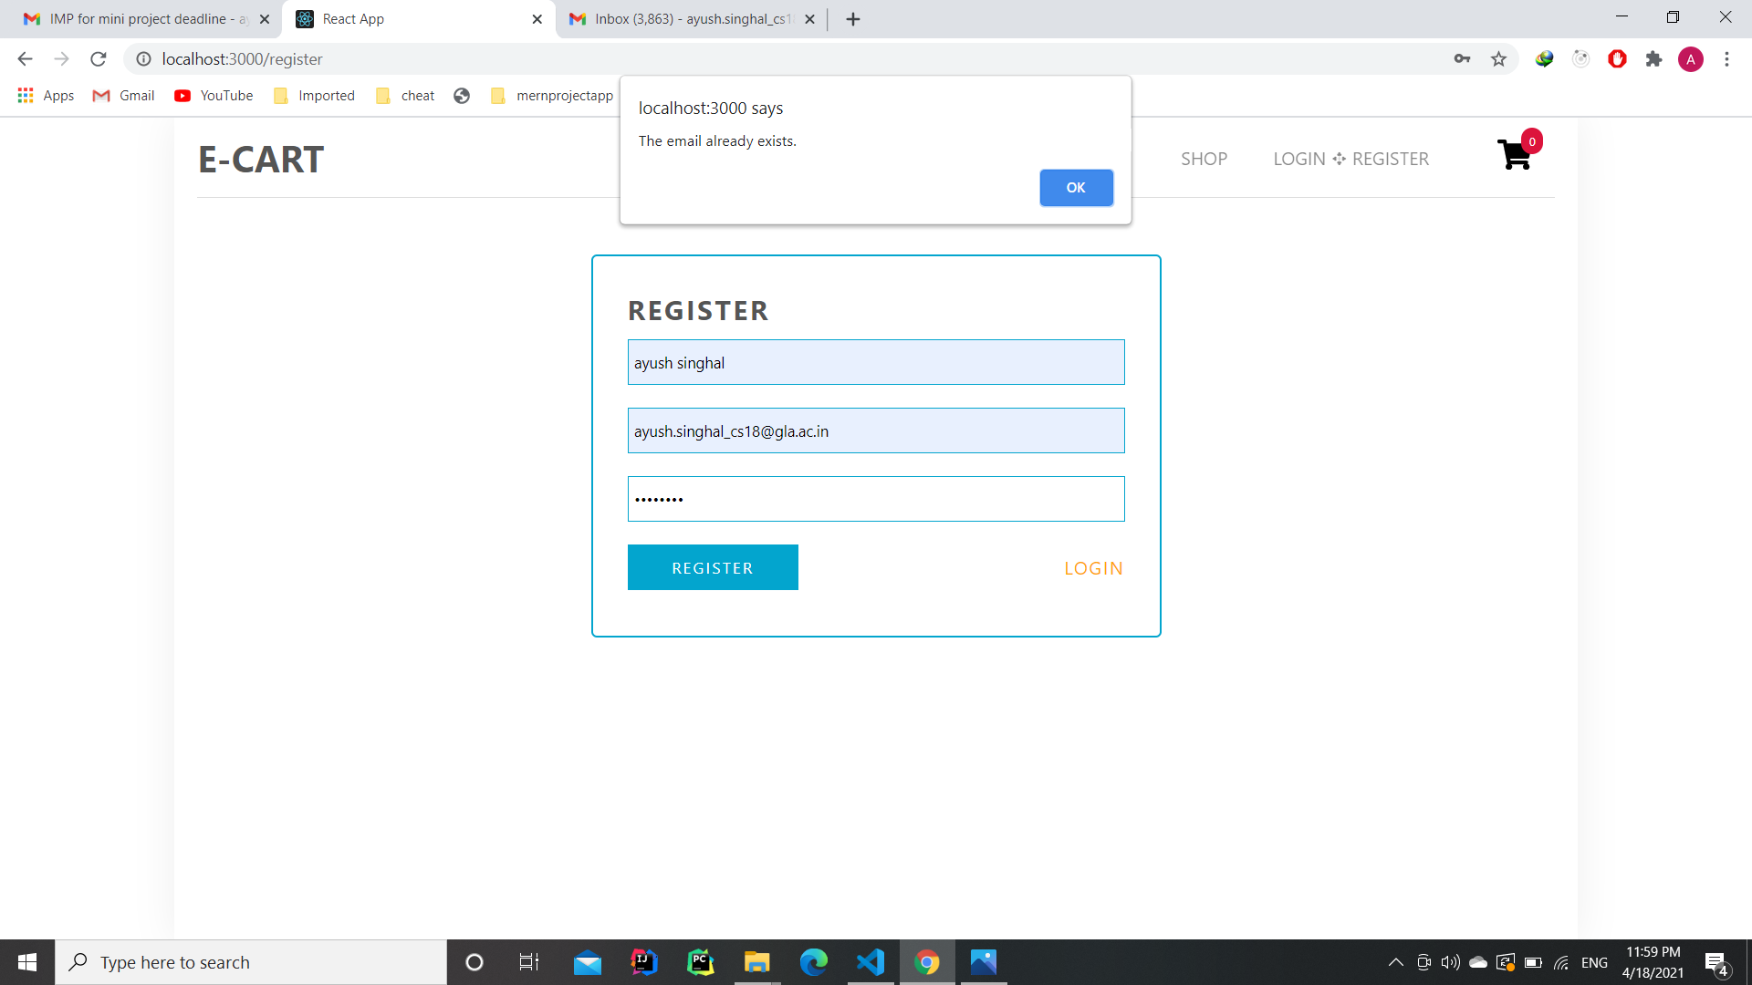
Register Page
After Filling out the Credentials

Slide 21
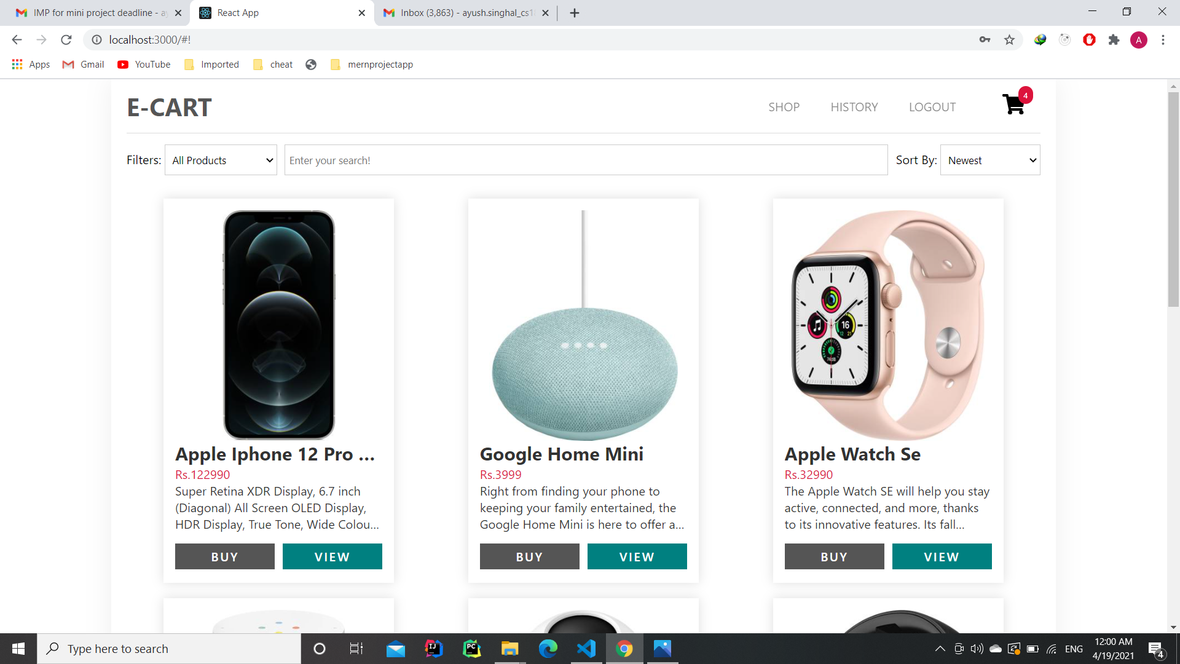
Dashboard After Logging In

Slide 22
Payment using PayPal

Slide 23
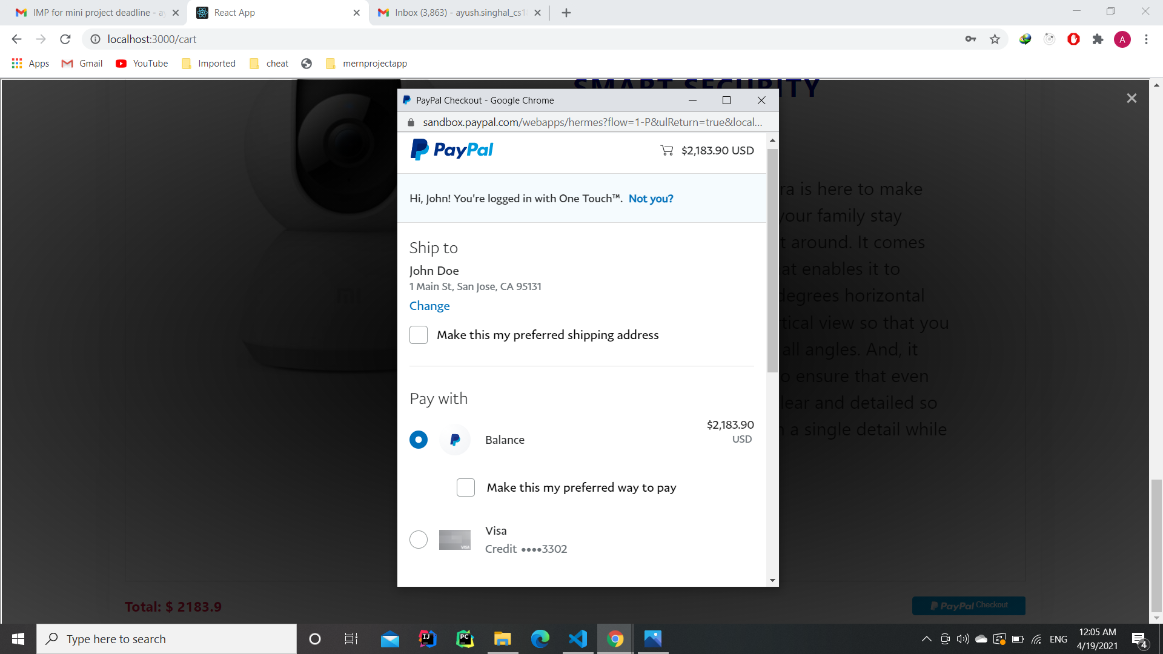
PayPal Payment Checkout

Slide 24
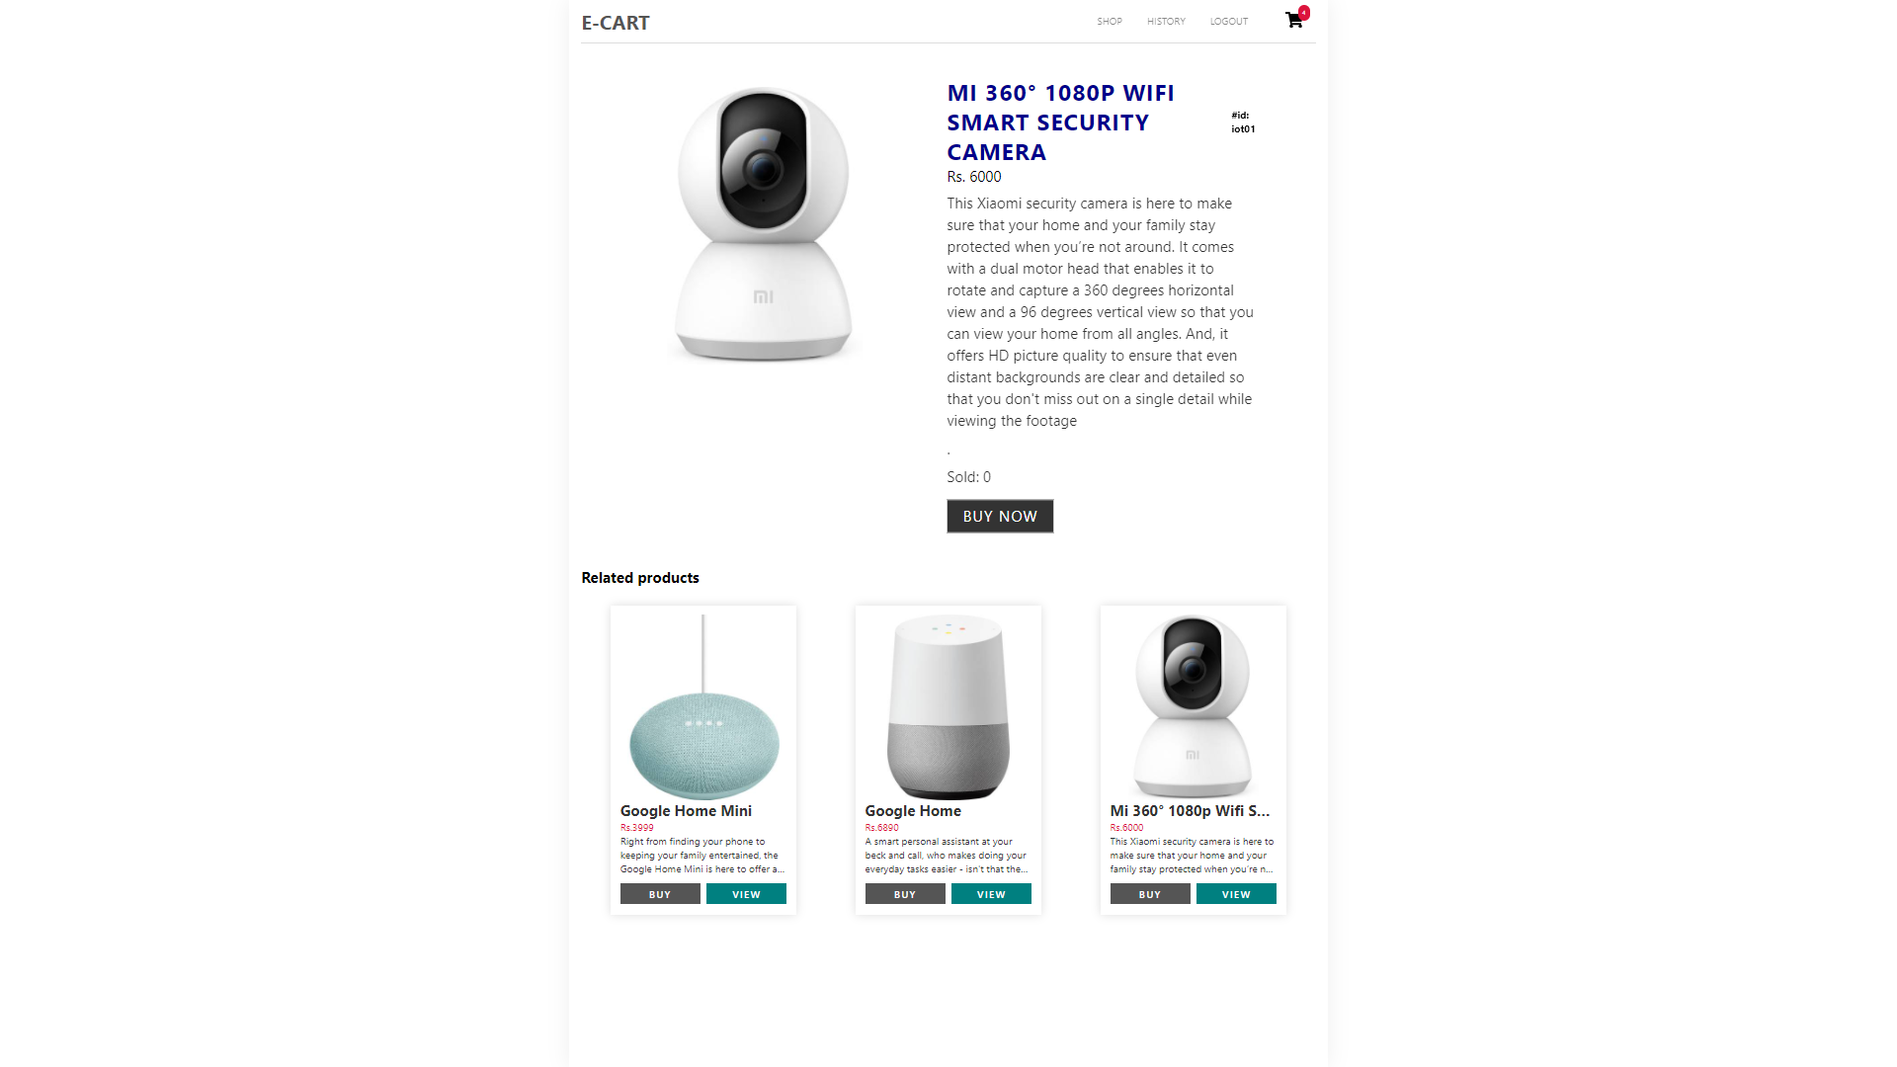
Product Description

Slide 25
THANK YOU

